Slide 1
Compensation: Personal Services
Compensation: includes salaries, wages, fringe benefits, pension etc
Allowability:
  Established Policy,
  National/Local Laws,
  Meets USAID standard of supporting documents,
  Must applied consistently to USAID and non-USAID.

Slide 2
Payroll Management
An efficient payroll system is the backbone of any successful organization. It ensures employees are paid accurately and on time, while keeping the company compliant with tax regulations and labor laws
The Payroll management system deals with the financial aspects of employee’s salary, allowances, deductions, gross pay, net pay etc and generation of pay slips for a specified period.

Slide 3
Payroll Management - key things to consider while making payroll
Preparing payroll involves several crucial steps to ensure accuracy and compliance with legal requirements. Here are some key things to consider:
Employee Information: We must ensure that we have accurate and up-to-date information for each employee, including their full name, address, social security number, tax withholding information, staff agreement ,salary or wage rate, and any applicable deductions or benefits.
Time sheet/ LOE report/Hours Worked: Track and record the number of hours worked by each employee during the pay period, including regular hours, overtime hours( as provision on policy), and any other types of hours (e.g., vacation, sick leave).
Employee Benefits, Bonuses ,overtime : Calculate benefits, bonuses, overtime pay for eligible employees according to policy, provision and laws. Ensure compliance with regulations regarding overtime rates and any exemptions that may apply and that need to be included in the payroll calculations.
Deductions and Withholdings: Deduct income taxes, as well as any other applicable withholdings such as Social Security, Medical, health insurance premiums, retirement contributions.
Review and Reconciliation: Review payroll sheet/reports and reconcile payroll data tax calculation sheet to ensure accuracy before processing payments to employees.

Slide 4
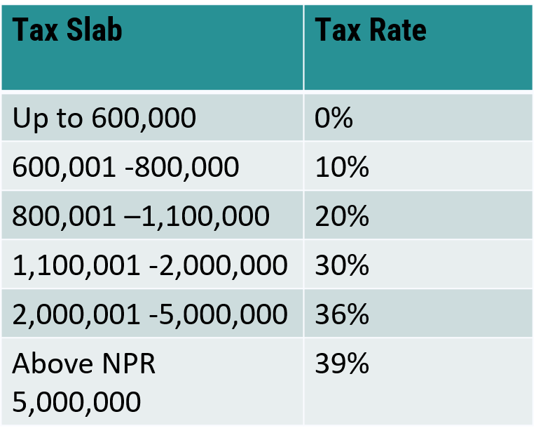
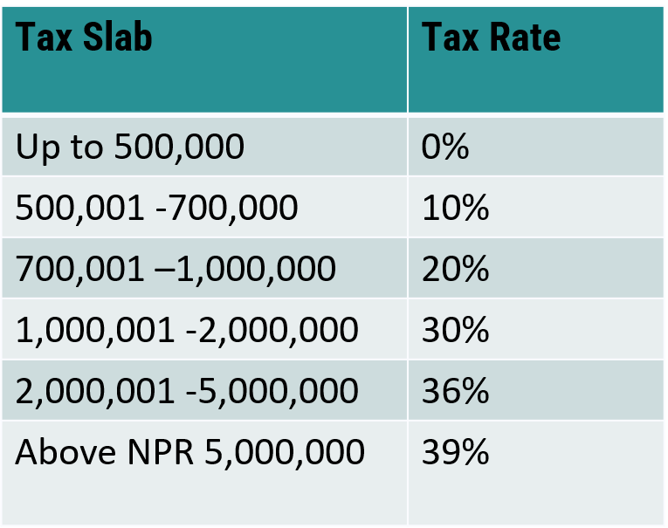
Payroll Management
Payroll Cycle :
Generally Nepalese organizations follow a monthly payroll cycle, so they receive their salaries at the end of every month. All employees must issue a pay slip to their employees once their salaries are credited.
Applicable tax rate as per income tax act
For Couple For Single

Slide 5
Applicable deduction in yearly Tax
life insurance Premium : A natural person who has procured life insurance and paid the premium amount thereon shall be entitled to a deduction from the taxable income the lower of the actual annual insurance premium or NRs 40,000.
Health insurance Premium: A natural person who has insured with a resident insurer/insurance company for health insurance shall be entitled to a deduction from the taxable income the lower of the actual premium paid or NRs 20,000.
Building Insurance Premium: A resident natural person who has insured a private building in his/her ownership with a resident insurer/insurance company shall be entitled to a deduction from the taxable income the lower of the actual annual premium paid or NRs 5,000.
Contribution to Approved Retirement Fund: In respect of contribution to an approved retirement fund, 1/3rd of taxable income or NRs 300,000 (NRs 500,000 if the contribution is done in SSF) or actual contribution whichever is lower.
Remote Area Benefit- NRs. 10,000 to NRs. 50,000 (Based on the Working Area)
Handicapped Benefit- For Couple NRs. 300,000 or For Single NRs. 250,000

Slide 6
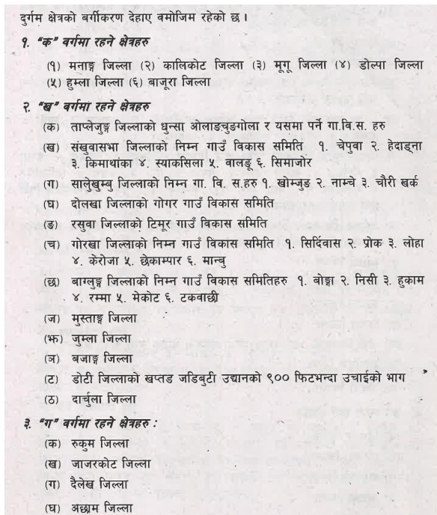
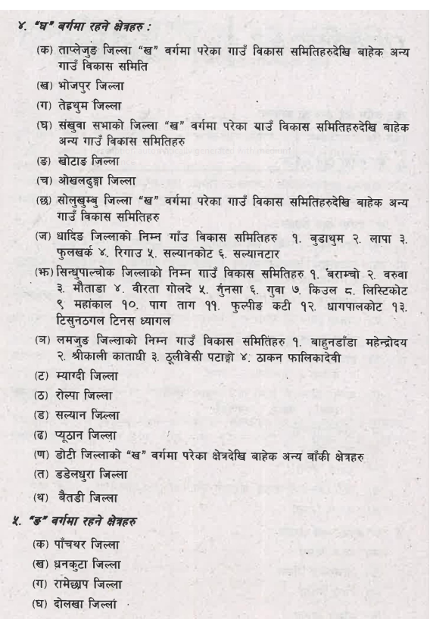
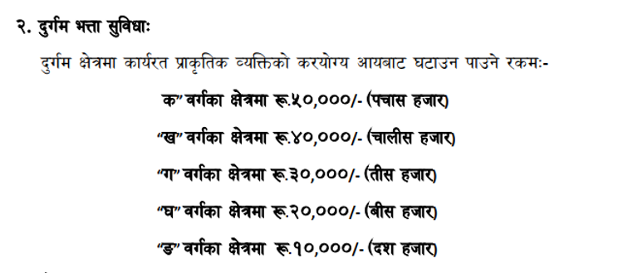
Remote Area Benefit

Slide 7
Practical session- Salary Calculation
Session 2 - Payroll Management.pptx

Slide 8
Thank You!

