Slide 1
Subaward Financial Report (SFR) & Its categories
FHI 360 issues and manages various subawards which require systems, standards, and expertise to minimize risk and ensure compliance with funder regulations and FHI 360 policies. All projects are required to monitor subaward expenditures and ensure they are aligned with project activities and the terms of the subaward.
Invoices or SFRs must be submitted by the due date specified in the invoicing clause of the subaward and with enough detail to determine the reasonableness of the charges.

Slide 2
Minimum documentation requirements for all cost-reimbursable subawards:
Invoice/SFR : If the sub awardee have their own invoice, they should issue and submit with SFR and does not have their own invoice, the FHI 360 SFR should be used. An invoice/SFR is required monthly from all sub awardees. At a minimum, invoices must include the following:
Obligated Budget
Previously reported expenditures, reported by budget category
Expenditures in the current reporting period, reported by budget category
Cumulative expenditures, reported by budget category

Slide 3
Minimum documentation requirements for all cost-reimbursable subawards:
Transaction List:
It is the detailed breakdown of all cost categories, for the reporting/billing period, as generated by the sub awardee's accounting system or manually prepared. Transaction list must include a transaction reference number (examples: Date, Budget heading, expenditure details, voucher number, check number etc) for each transaction. This reference number must be included in the file name of the corresponding supporting documentation.
If providing a manual report, transactions should be reported by major budget line category, matching the SFR. The transaction list should, at a minimum, include the date of the transaction, vendor name, description of transaction, transaction amount and reference number. A transaction list is required from all sub awardees with each monthly invoice/SFR.

Slide 4
Minimum documentation requirements for all cost-reimbursable subawards:
Labor Summary and payroll :
List of employees including name, position title, basic/gross pay, net pay, allowances (any allowances like transportation, meals, etc.), fringe benefits paid by the employer and employee, tax withheld, and hours or days worked for the project during the reporting/billing period. A labor summary is required from all sub awardees with each monthly invoice/SFR. This listing is accompanied by the copied time sheets.

Slide 5
Documentation by Expenses Category
Salaries | Payroll report Time sheet Time and salaries must be actually not budgeted one Salary rate must be per employment contracts issued and payroll records Verification of Debarment and Terrorism Searches

Slide 6
Documentation by Expenses Category
Fringe Benefits | Detail itemized by employee Appropriate supporting calculation and copy of regulation or organizational policy that explains or mandates the benefit Evidence of payroll withholding, taxes, insurance, pension, and other required payroll obligations

Slide 7
Documentation by Expenses Category
Consultants | For initial payment: ✓ Copy of signed consultancy agreement/contract ✓ Documentation of selection process including price reasonableness and documentation of competition ✓ Verification of terrorism and debarment searches {Excluded Parties List (Debarred, Suspended, and Ineligible Contractors), OFAC list as ineligible, UN List of Sanctioned Entities as ineligible} ✓ Consultant invoice ✓ Certification of deliverables & time worked by the consultant as stated in the agreement by person overseeing the consultancy on behalf of the subrecipient

Slide 8
Documentation by Expenses Category
Consultants | For subsequent payments: ✓ Consultant invoice ✓ Certification of deliverables and time worked by the consultant as stated in the agreement by person overseeing the consultancy on behalf of the subrecipient ✓ Documentation supporting bank payment transfers and schedules submitted to local government for payment of consultant taxes submitted during the period, if

Slide 9
Documentation by Expenses Category
Travel, Transport and Per Diem | Copy of approval for travel EA/TO etc Receipt/Invoices for lodging, airfare, car rental etc Per Diem calculation per policy Documentation of dates, travelers, programmatic necessity Trip Report

Slide 10
Documentation by Expenses Category
Procurements | Approval from donor if applicable Purchase Requisition RFP for collection of quotations Vendor Selection Process-Competition, price and reasonableness, Purchase Order Good Receipt Note/Services performed or delivered Invoices Debarment & Terrorism Searches (SAM, OFAC & UN)

Slide 11
Documentation by Expenses Category
Other Direct Costs | Receipts or invoice for all items Goods received note signed by the employee who received item(s), when applicable Evidence of vendor selection process and price reasonableness Purchase order, if applicable Verification of terrorism and debarment searches (Excluded Parties List [Debarred, Suspended, and Ineligible Contractors], OFAC list as ineligible, UN List of Sanctioned Entities as ineligible), if applicable

Slide 12
Things to remember in every payments and every time
Reasonable: Are the invoiced costs reasonable? Costs are not excessive, supported in actual cost data and items and quantities are determined to be appropriate for the tasks/activities performed.
Allowable: Is the expense allowable under the funder’s regulations? 2 CFR 200 Subpart E provides details on different cost categories and specifies what costs can be expended under a USG award. A detailed list of selected items of cost begins in 2 CFR 200.420 and continues through section 2 CFR 200.476
Costs must be allowable under this regulation to be considered for funding. Additionally, the US Government has determined that certain items cannot be procured using USG funding under any circumstances. While instances of programs that would encounter these types of expenditures are rare, please note that these items cannot be considered for inclusion in the sub awardee's budget.

Slide 13
Things to remember in every payments and every time
Allocable: Was the expense required to complete the work? All expenditures must be allocable to the program, meaning that the cost must be derived from the sponsored activity. FHI 360 cannot pay for costs attributable to other activities of the organization.
Note: Reviewing costs for reasonableness, allowability and to ensure they are allocable are required for all subawards.

Slide 14
Documents order in SFR
SFR
Advance request
Salaries (ledger, payroll and deposit /transfer documents)
Fringe (Ledger, Fringe calculation sheet, Deposit documents)
Ledger of all expenses categories
Checking accounts, BVA, Fund Accountability Statement, BRS with Bank statement, Trial balance, Inventory report, VAT statement.

Slide 15
Possible Errors in SFR
Missing Modification/Amendment no in SFR page
Mistake in Subaward start and end date, Reporting month
Current obligation amount ( If modified), Previously reported expenses
Advance calculation for upcoming months (same for every month)
e-signature used in SFR (Excel sheet)encourage to use real signature.
6. Note for any changes in salary (paid days, unpaid days, any deduction, left date, joining date)
7. Keep approval sheet and mention in the BVA if any changes (for budget line item)

Slide 16
Critical steps of invoice review include:
Review the SFR/Invoice submission package to make sure that minimum required documentation is included.
Perform arithmetic check on the reported expenditures (cumulative amounts tied to previously reported amounts, all summations are correct, etc.)
Verify that the previous cumulative amounts per budget category, and in total, match the cumulative amounts from the previous invoice.
Verify that the total expenses reported in the reporting period match the total from the transaction list. Complete a similar check for each budget category (e.g. Ensure that the sum of all travel related items in the transaction list matches the sum reported under travel.)
Perform a math check to ensure that the previous cumulative totals added to the reporting period totals equal the total cumulative figures, by budget category

Slide 17
Critical steps of invoice review include:
Verify and crosscheck any other information on the invoice as possible (e.g. Check that the amount indicated as received from FHI 360 matches FHI 360 records of fund sent/FHI ledger.)
Ensure that staff/positions listed in the labor summary were named in the budget, and that the rates being billed are actuals based on payroll records.
If any listed transactions appear unusual, excessive, or unrelated to the program, the sub awardee should be contacted to resolve any concerns before the invoice is approved.
3. Thoroughly review supporting documentation using Sample Documentation. Ensure documentation matches transaction details in transaction summary. Be on the lookout for indications of fraud or erroneous documentation.
4. Complete the SFR Review Checklist
5. Certify the Checklist

Slide 18
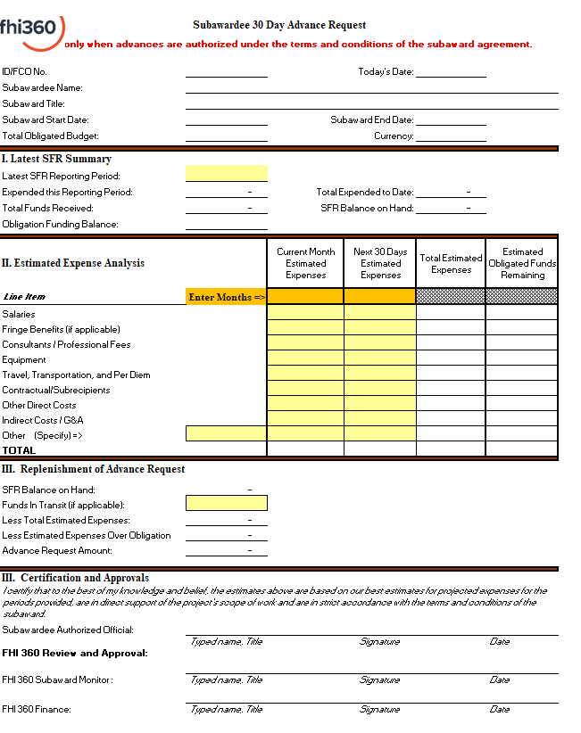
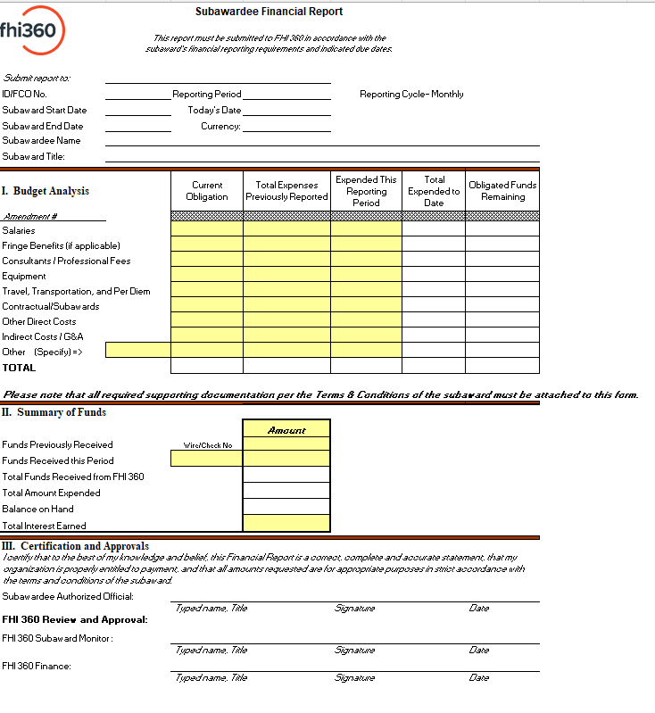
SFR template and Instruction

Slide 19
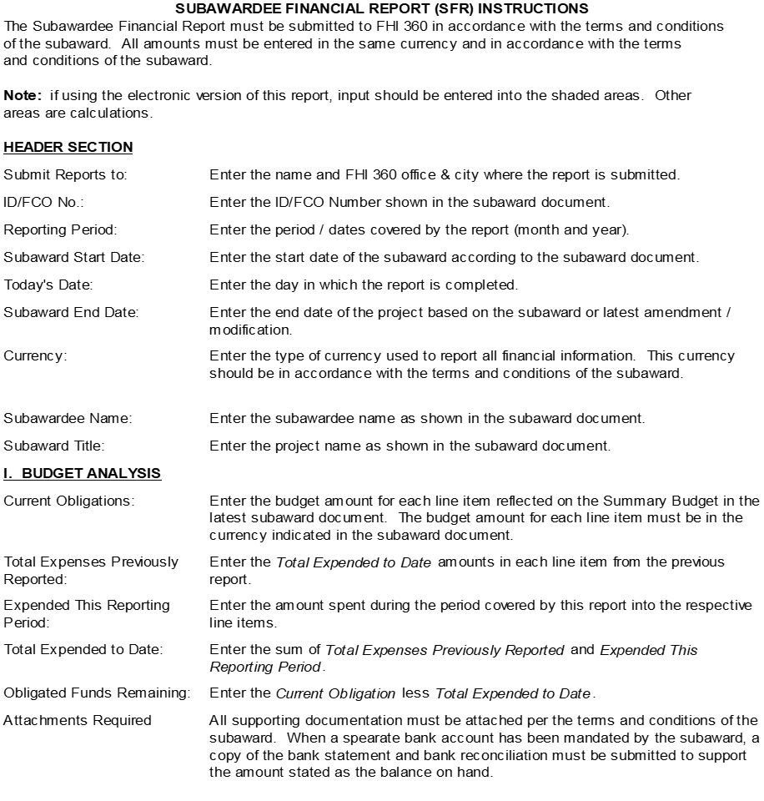
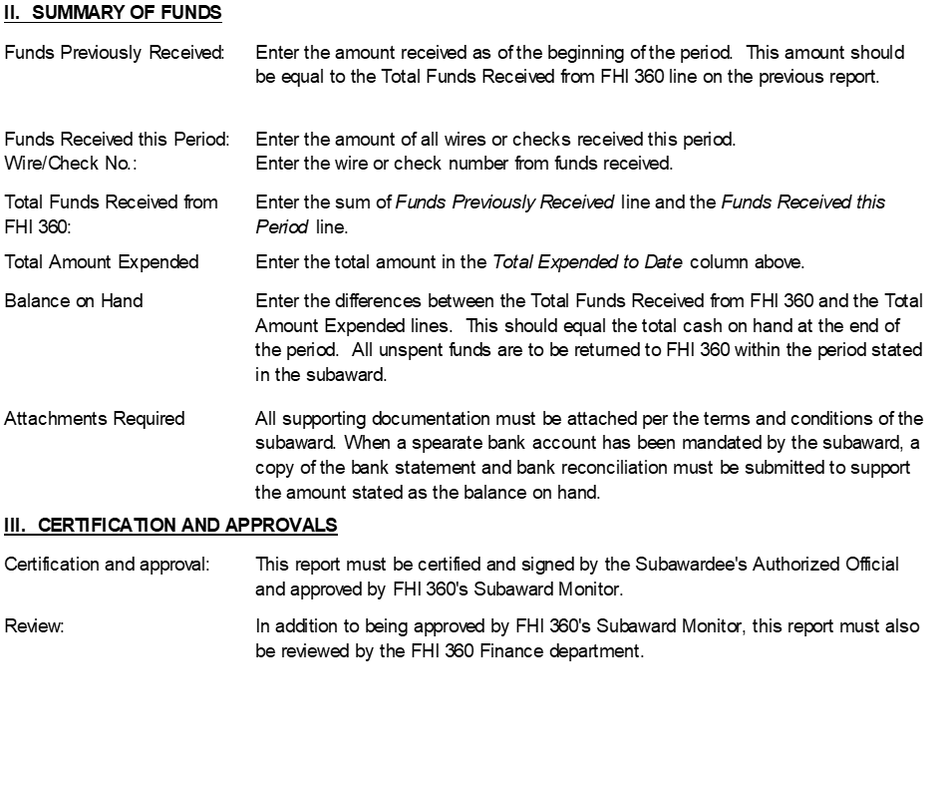
SFR template and Instruction​

Slide 20


Slide 21


