Slide 1
Grants and Financial Management Training
May 22-24, 2024

Slide 2
CONTENTS
M29. Prohibition on Certain Telecommunication and Video Surveillance Services or Equipment (July 2022)
RAA1. ADVANCE PAYMENT AND REFUNDS (NOVEMBER 2020)
RAA11. REPORTING HOST GOVERNMENT TAXES (DECEMBER 2022)

Slide 3
M29. Prohibition on Certain Telecommunication and Video Surveillance Services or Equipment (July 2022)
Recipients and subrecipients are prohibited from obligating or expending grant funds to :
(1) Procure or obtain;
(2) Extend or renew a contract to procure or obtain; or
(3) Enter into a contract or extend or renew a contract to procure or obtain equipment, services, or systems that uses covered telecommunications equipment or services

Slide 4
M29. Prohibition on Certain Telecommunication and Video Surveillance Services or Equipment (July 2022)
covered telecommunications equipment is telecommunications equipment produced by Huawei Technologies Company or ZTE Corporation (or any subsidiary or affiliate of such entities) and
video surveillance and telecommunications equipment produced by Hytera Communications Corporation, Hangzhou Hikvision Digital Technology Company, or Dahua Technology Company (or any subsidiary or affiliate of such entities

Slide 5
RAA1. ADVANCE PAYMENT AND REFUNDS (NOVEMBER 2020)
The recipient is not required to maintain separate bank accounts for USAID funds, unless otherwise required.
When advances are authorized, the recipient must deposit such funds in a reputable bank and
Be able to account for the receipt and expenditure of funds and interest earned on the advances provided.

Slide 6
RAA1. ADVANCE PAYMENT AND REFUNDS (NOVEMBER 2020)
The recipient must maintain advances of USAID funds in interest-bearing accounts, unless:
  The recipient receives less than $250,000 per year;
  The best reasonably available interest-bearing account would not be expected to earn interest in excess of $500 in a twelve month period;
  The bank would require an average or minimum balance so high that it would not be practical to maintain the advance in an interest-bearing account; or
  A foreign government or banking system prohibits interest bearing accounts.

Slide 7
RAA1. ADVANCE PAYMENT AND REFUNDS (NOVEMBER 2020)
The recipient may retain up to $500 of interest earned in a twelve-month period on cash balances for administrative expenses. Any additional interest earned on advances must be remitted to prime.

Slide 8
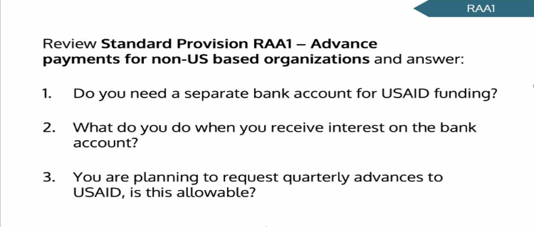
EXCERCISE

Slide 9
RAA11. REPORTING HOST GOVERNMENT TAXES (DECEMBER 2022)
Definitions:
Foreign government includes any foreign governmental entity.
Foreign taxes include value-added taxes and customs duties assessed on procurement of goods and services.
Report:
  The recipient must submit a report detailing foreign taxes assessed during prior year. The report must be submitted annually by April 16.
  A report is required even if the recipient did not pay any foreign taxes during the reporting period.
  A cumulative report may be provided if the recipient is performing more than one award.
  Report includes any individual transaction of more than $500 should be reported.

Slide 10
Reporting Requirements
Reports | Frequency
SFR | Monthly
SFR Accrual | Quarterly
QNR/QWP/Narrative Reports | Monthly/Quarterly
Cost Share | Quarterly
VAT Reports | Annually
Inventory Reports | Annually including physical verification report
Audit Report, Management Letter | Annually
DAO, SWC, Tax Exempt Certificate | Annually (as applicable)
Audit Monitoring per M2 End of Project Report (EoPR) | Annually 30 Days after POP ends

Slide 11
Upcoming Changes
In April 2024, the OMB issued revisions to several parts of the 2 CFR 200 (Uniform Administrative Guidance).
The effective date for the final guidance is October 1, 2024. Agencies may elect to apply the final guidance to awards issued prior to October 1, 2024, but they are not required to do so.
However, the effective date for the increase in the audit thresholds are not clear.

Slide 12
Key Changes
Single Audit or Program Specific Audit threshold increased from $750,000 to $1,000,000.
Equipment threshold for retention, sale, or disposal raised from $5,000 to $10,000.
Unused supplies threshold required to be sold at the end of a award period increased from $5,000 to $10,000.
De Minimis indirect rate increased from 10% to 15%.
Amount of subawards recipients can apply to the indirect rate raised from $25,000 to $50,000.
Simplified Acquisition Threshold (SAT) limit for fixed amount subawards increased from $250,000 to $500,000

Slide 13
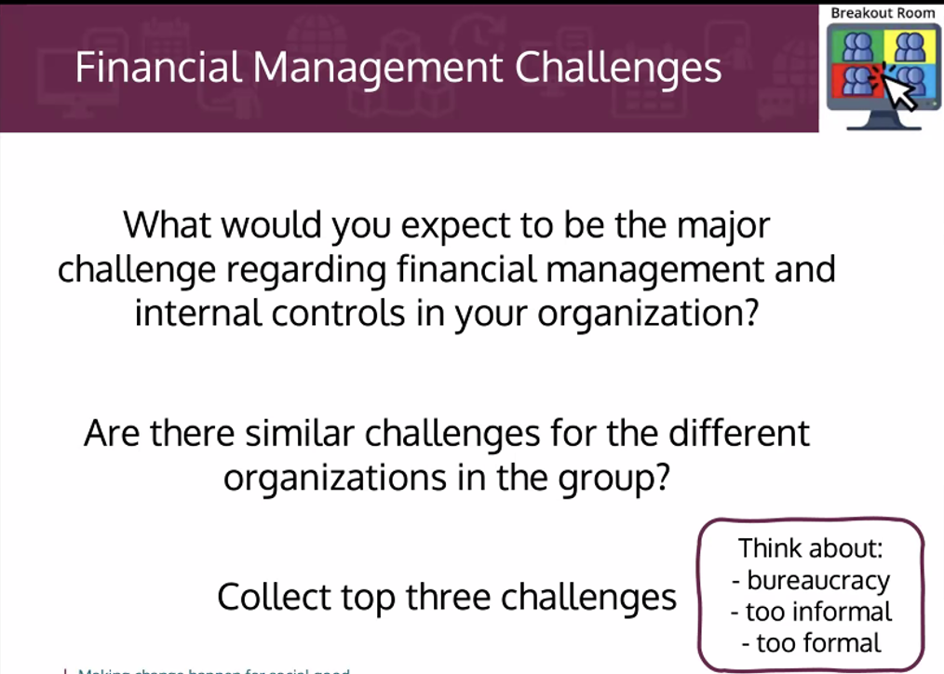
Financial Management

Slide 14
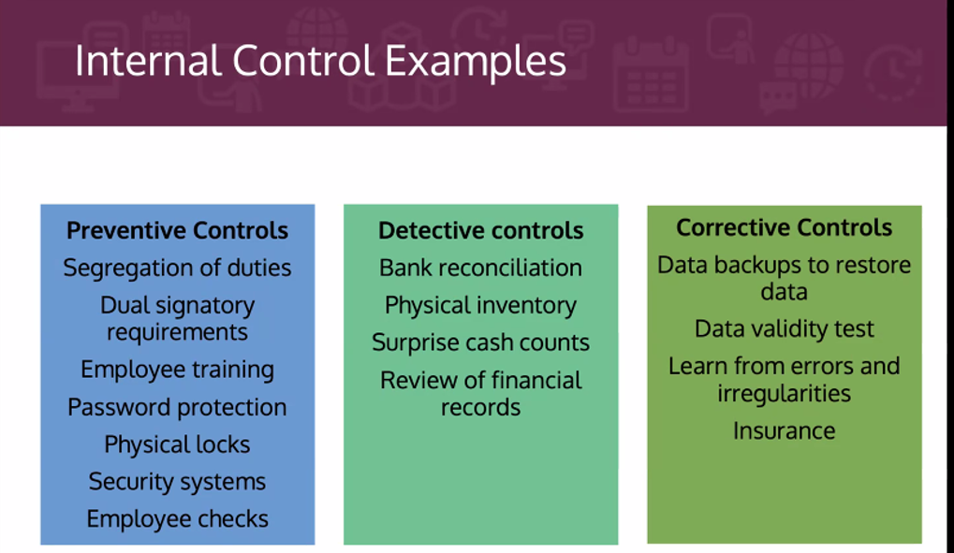
Internal Control

Slide 15
Thank You!

