Slide 1
Grants and Financial Management Training
May 22-24, 2024

Slide 2
VAT and Inventory Reporting
FHI 360 is required to submit an annual Foreign Tax Report to the US Government every April. The purpose of this report is to ensure that US foreign assistance is not being taxed and that funds are used for their intended purposes. The USG uses these reports to track whether foreign governments are complying with the terms of their bilateral agreements.
VAT information must be reported on the purchase of all commodities for all awards receiving USAID funds. All sub-recipients under USAID awards must also track taxes paid and reimbursements received on purchases of NPR 10000 or more.

Slide 3
Information needs to be included on a VAT invoice
1. Registered dealer name should be clearly visible : XYZ concern
Address : Baluwatar, Kathmandu
VAT Number :
2. Purchaser’s name in Invoice: Name should be FHI/USAID
Organization Name : FHI/USAID Organization
Address : Baluwatar ,Kathmandu
PAN No:
3. Invoice Date : Invoice issue date is mandatory.

Slide 4
Information needs to be included VAT report
Ensure the supplier's name is clearly visible. When picking the invoice from the invoice pad, the name should not be hidden.
The invoice number must be complete and clear. Write the full invoice number, including both letters and numbers (e.g., if the invoice number is BAN2357, write "BAN2357" in full).
Buyer’s PAN no and Name should be correct ( FHI/USAID – 303628617)
Don't change the date format in the VAT statement. Use the date format exactly as it appears on the invoice, whether it's in English or Nepali, but ensure it's in the Year-Month-Day (Y.M.D) format.
Report only the final issue date of the invoices even though there might be multiple dates mentioned in the invoices like ;Arrival date, Departure date, Transaction date and Issued date.
Update and track the VAT refund status immediately upon receiving refund information and the amount.

Slide 5
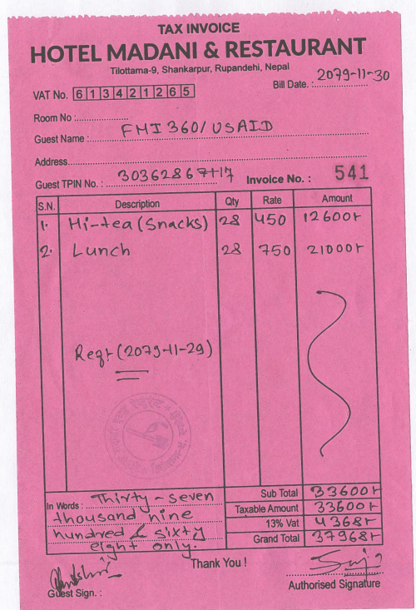
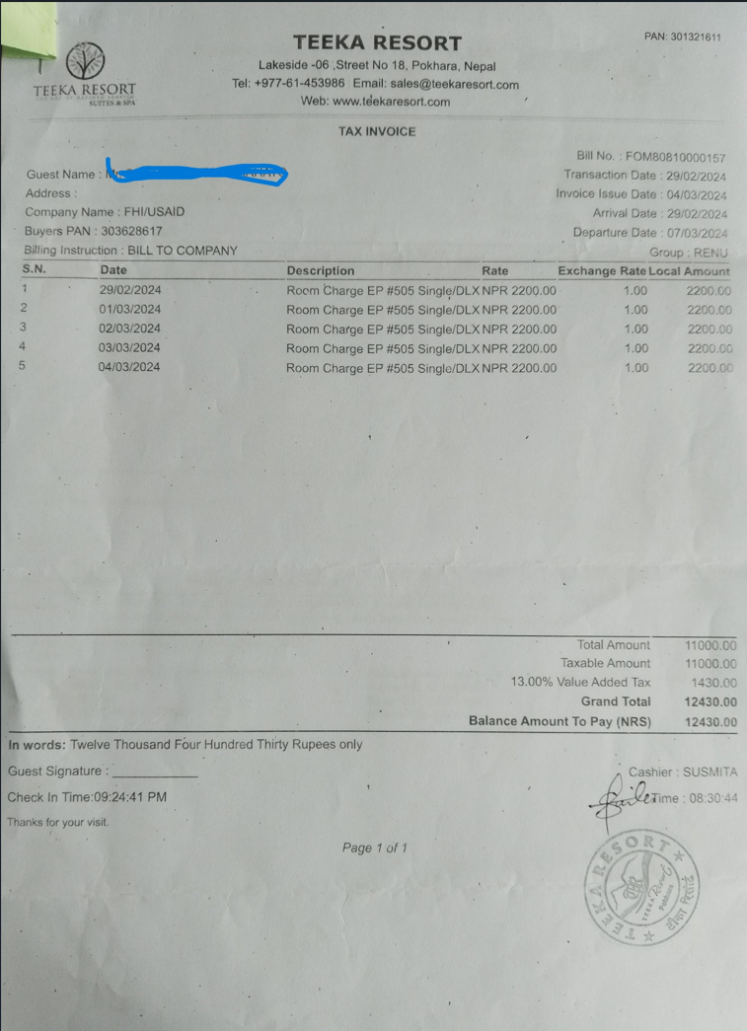
Invoice Sample

Slide 6
VAT report sample
After verify the invoices and VAT statement report received from Ips concerned grants person will submit entire report along with invoices to admin department of FHI Country office.

Slide 7
Challenges of VAT reporting and VAT refund
International Non-Governmental Organizations (INGOs) often face several challenges in refunding VAT from Inland Revenue Offices. These challenges can include
Complex Procedures
Delayed Processing
Lack of Clarity
Documentation Requirements
Inconsistency in Interpretation
VAT Non-filler vendor
Frequent changes of Tax officer

Slide 8
Our Initiation to get full refund
Thoroughly review the invoices and VAT statement report in different department.
Maintain Accurate and Comprehensive Documentation
Communicate vendor to inform the VAT filing status ( Zero VAT submission, Non-filler)
Provide all supporting documents (like contracts, USAID circular) to IRD
Establish Good Communication with Tax Authorities and coordinate and keep close consultation with Tax officer about the changes in requirements.
Follow Up Regularly:-
Track Progress: Monitor the status of our refund application regularly and follow up with the tax office if there are delays.
Regular Updates: Request regular updates from the Inland Revenue Office on the status of your refund.

Slide 9
Inventory Management
Inventory management is the process of tracking the goods and materials used by an organization to procure or sell goods.
The goal of inventory management is to ensure effectiveness and uses of organizational assets to fulfil organizational goal.

Slide 10
Assets Physical Verification
Physical asset verification acts as a deterrent for asset misappropriation and reduces the risk of financial losses and fraud.
It is useful as it discloses any weaknesses or defects in the system for the custody and control of stocks, besides bringing the stock accounts up-to-date.
It reveals the possibility of fraud, theft, or loss and suggests the adoption of additional preventive measures to stop them.

Slide 11
Why do we do physical verification?
To ensure the accuracy of asset records and inventory levels. By physically inspecting and verifying items, organization can identify discrepancies or inconsistencies and take corrective actions to maintain accurate records.
It is an audit requirement that physical verification of all stocks are carried out at least once a year.
It checks the accuracy of store records and brings about an update/status of the store section, especially its physical condition.
It reveals the possibility of fraud, theft, or loss and suggests the adoption of additional preventive measures to stop them.
Reveals losses due to wrong issues, negligence, misappropriations, misuse or leakage, theft, etc. and suggests measurement to stimulate better control.
Helps in clearing up surplus and obsolete items, thus avoiding locking up resources.

Slide 12
Inventory Reporting and its requirements
Record of all nonexpendable items as per the provision.
Inventory code, item description, serial no, acquisition date, value and assets condition must be clearly mentioned in the inventory report.
USAID logo must be affixed in all nonexpendable items.
Physical verification should be done at least once in a year or as per provision in policy.

Slide 13
M7. TITLE TO AND USE OF PROPERTY (DECEMBER 2014)
Title to all Property financed under this award vests in the recipient upon acquisition unless otherwise specified in this award.
Property means equipment, supplies, real property, and intangible property, each defined individually below.

Slide 14
M7. TITLE TO AND USE OF PROPERTY (DECEMBER 2014)
Equipment means tangible nonexpendable property having a useful life of more than one year, and an acquisition cost of $5,000 or more per unit. However, consistent with the recipient’s policy, lower limits may be established.
Supplies means tangible property excluding equipment. A computing device is a supply if the acquisition cost is less than $5,000 per unit.
Real Property means land, including land improvements, structures and appurtenances, including permanent fixtures.
Intangible Property includes intellectual property, such as trademarks, copyrights, patents and patent applications etc.

Slide 15
M7. TITLE TO AND USE OF PROPERTY (DECEMBER 2014)
Use and maintain all Property in accordance with the following procedures:
Must use the Property for the program for which it was acquired during the period of this award.
When the Property is no longer needed, the recipient must use the Property in the following order of priority:
  Activities funded by USAID,
  The Activities funded by other United States Government (USG) agencies, then
  As directed by the FHI 360.

Slide 16
M7. TITLE TO AND USE OF PROPERTY (DECEMBER 2014)
The recipient must maintain the Property in good condition, have management procedures to protect, and maintain an accurate inventory. Maintenance procedures must include the following:
Accurate description of the Property, including serial number, model number, or other identifying number, acquisition date and cost, location and condition, and data on the disposition of any Property (date of disposition, sales price, method used to determine current fair market value, etc.), as applicable.
A physical inventory of Property that must be taken, and the results reconciled with the equipment records, following organizational policies period of this award.
A control system must be in effect to maintain the Property and ensure adequate safeguards to prevent loss, damage, or theft of the Property.
The recipient must maintain appropriate insurance equivalent to insurance the recipient maintains for its own property.
Any loss, damage, or theft must be investigated and fully documented, and the recipient must promptly notify FHI 360.
The recipient may be liable where insurance is not sufficient to cover losses or damage.

Slide 17
M7. TITLE TO AND USE OF PROPERTY (DECEMBER 2014)
Upon completion of this award, the recipient must submit to FHI 360 a property disposition report of the following types of Property, along with a proposed disposition of such Property.
  All equipment that has a per unit current fair market value at the end of this award of $5,000 or more.
  New/unused supplies with an aggregate current fair market value at the end of this award of $5,000 or more.
  Real or intangible property, of any value.

Slide 18
M7. TITLE TO AND USE OF PROPERTY (DECEMBER 2014)
The recipient must dispose the Property at the end per disposition report. Disposition may include the following:
  The recipient may retain title with no further obligation.
  The recipient may retain title, but must compensate for the share, based on the current fair market value of the Property.
  The recipient may be directed to transfer title to a third party, including another implementing partner or the host country government.

Slide 19
Thank You!

