Slide 1
Grants and Financial Management Training
May 22-24, 2024

Slide 2
OVERALL OBJECTIVES
Enhance capacity of our implementing partner on grants and financial management.
The training will contribute to the indicator of capacity development of implementing partners.
Will have increased impact on financial documentation, governance system, reporting, and grants compliances which will ultimately support to achieve greater objectives of the organization.

Slide 3
SPECIFIC OBJECTIVES
Understand the USAID cost principle: Reasonable. Allocability & Allowability.
Understand basic rules about interest Earned, Ineligible and Restricted Items,
Debarment and terrorism searches.
Gain clarity on preparation of Human Resources for Health reporting.
Identify the local compliance requirements related with Tax/VAT
Improve the overall inventory management
Prepare and submit qualitative financial report
Improve internal control mechanisms
Analyze budget monitoring reports and budget management techniques and tools which will support improving the burn rate of the Implementing Partners.

Slide 4
CONTENTS
M1. ALLOWABLE COSTS (NOVEMBER 2020)
M2. ACCOUNTING, AUDIT, AND RECORDS (MARCH 2021)
M5. PROCUREMENT POLICIES (JUNE 2012)
M6. USAID ELIGIBILITY RULES FOR PROCUREMENT OF COMMODITIES AND SERVICES (MAY 2020)
M7. TITLE TO AND USE OF PROPERTY (DECEMBER 2014)
M11. RECIPIENT AND EMPLOYEE CONDUCT (OCTOBER 2023)

Slide 5
CONTENTS
M12. DEBARMENT AND SUSPENSION (JUNE 2012)
M14. PREVENTING TRANSACTIONS WITH, OR THE PROVISION OF RESOURCES OR SUPPORT TO, SANCTIONED GROUPS AND INDIVIDUALS (MAY 2020)
M28. CONFLICT OF INTEREST (August 2018)
M29. Prohibition on Certain Telecommunication and Video Surveillance Services or Equipment (July 2022)
RAA1. ADVANCE PAYMENT AND REFUNDS (NOVEMBER 2020)
RAA11. REPORTING HOST GOVERNMENT TAXES (DECEMBER 2022)

Slide 6
Standard Provisions for Non-U.S. Nongovernmental Organizations
Mandatory Provisions (M) | Required As Applicable (RAA)
32 | 31

Slide 7
Contracts and Grants
Contracts | Grants and Cooperative Agreements
Mechanism of acquisition/procurement | Mechanism for assistance
U.S. Government is the buyer, exercise full control | U.S. Government is the sponsor, limited involvement and for public purpose
U.S. Government is the primary beneficiary | The recipient is the primary beneficiary (Public at Large/communities)
Contracts Officer | Agreement Officer/Grants Officer
Contracting Officer’s Technical Representative (COTR) | Agreement Officer’s Technical Representative (AOTR)
Request for Proposal (RFP), Federal Acquisition Regulation (FAR) | Request for Application (RFA), Code of Federal Regulation (CFR)

Slide 8
Awarding Process
Pre-award
Award
Post-award
Closeout

Slide 9
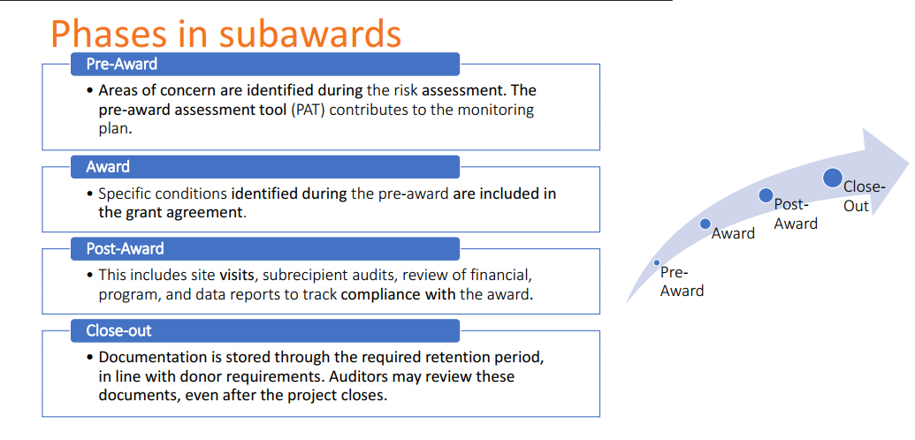
Awarding Process

Slide 10
Cost Share Vs Shared Cost (Cost Allocation)
Cost Share-leverages or additional resources contributed by grantee (time, supplies, cash, property and equipment, complimentary projects etc)
Shared cost: costs that benefits more than a program projects. A cost allocation plan is a written summary which shows how an organization may share costs across many projects.

Slide 11
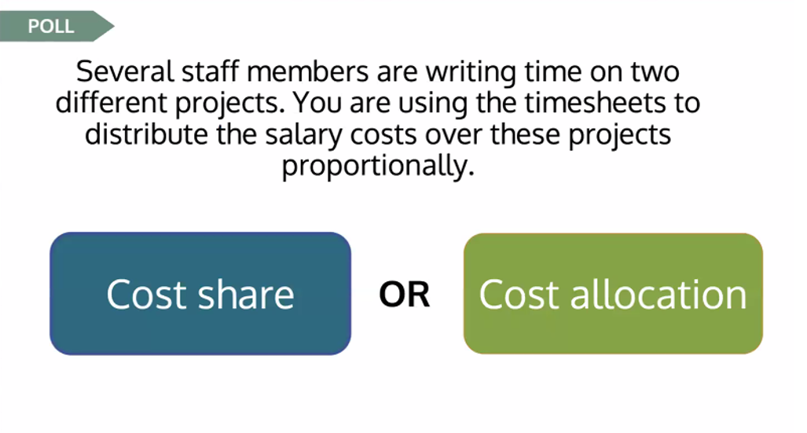
Cost Share vs Cost Allocation

Slide 12
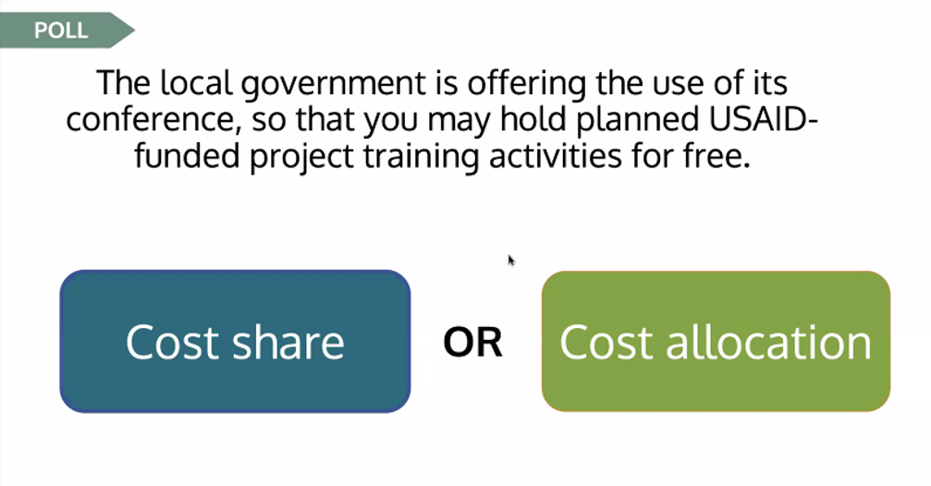
Cost Share vs Cost Allocation

Slide 13
M1. ALLOWABLE COSTS (NOVEMBER 2020)
The recipient will be reimbursed for costs incurred in carrying out the purposes of this award and the applicable cost principles in effect.
The recipient must retain documentation to support charges to this award for a period of three years from the date of submission of the final expenditure report.
Refer to 2 CFR 200 SUBPART E-COST PRINCIPLES for details

Slide 14
Allowability of Costs
Be necessary and reasonable for the performance of the award and be allocable under these principles.
Conform to any limitations or exclusions set forth in cost principles or in award.
Be consistent with policies and procedures that apply uniformly to both federally-financed and other activities of the recipient.
Be accorded consistent treatment. A cost may not be assigned as a direct cost if any other cost incurred for the same purpose in like circumstances has been allocated as an indirect cost.

Slide 15
Allowability of Costs
Be determined in accordance with generally accepted accounting principles (GAAP).
Not be included as a cost or cost sharing or matching requirements of any other federally-financed program in either the current or a prior period.
Be adequately documented
Cost must be incurred during the approved budget period.

Slide 16
Reasonableness of Costs
A cost is reasonable if, in its nature and amount, it does not exceed that which would be incurred by a prudent person under the circumstances prevailing at the time the decision was made to incur the cost.
For determining reasonableness of a given cost, consideration must be given to:
  Whether the cost is ordinary and necessary for the operation and efficient performance of the award.

Slide 17
Reasonableness of Costs
Factors such as sound business practices; arm's-length bargaining and terms and conditions of the award
Market prices for comparable goods or services
Whether acted with prudence in the circumstances considering responsibilities`
Whether significantly deviates from its established practices and policies regarding the incurrence of costs

Slide 18
Allocability of Costs
A cost is allocable if the goods or services involved are chargeable in accordance with relative benefits received. This standard is met if the cost:
  Is incurred specifically for the Federal award;
  Benefits both award and other work of the entity and can be distributed in proportions that may be approximated using reasonable methods; and
  Is necessary to the overall operation of the entity and is assignable in part to the award.

Slide 19
Selected items of cost
Entertainment
Alcohol
Fines and Penalty
Advertisements & Public Relation cost
Donation and contributions
Contingency Provision
Gift
Bad Debts
Idle Facility and Idle Capacity
Pre-award costs
Depreciation

Slide 20
Compensation: Personal Services
Compensation: includes salaries, wages, fringe benefits, pension etc
Allowability:
  Established Policy,
  National/Local Laws,
  Meets USAID standard of supporting documents,
  Must applied consistently to USAID and non-USAID.

Slide 21
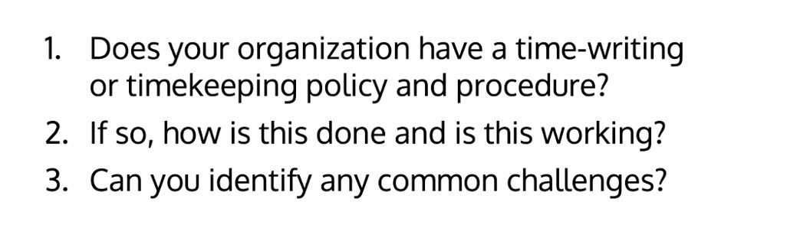
Share Experiences

Slide 22
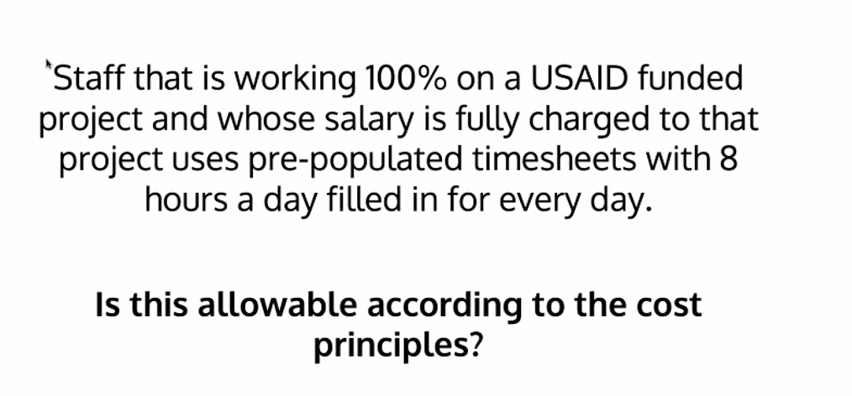
What do you think?

Slide 23
M2. ACCOUNTING, AUDIT, AND RECORDS (MARCH 2021)
The recipient is required to have an annual audit for any recipient fiscal year in which the recipient expends a combined total of more than $750,000 in all federal awards, either directly or through a prime contractor or recipient.
USAID/FHI 360/or any designated agency retains the right to conduct financial review, require an audit, or otherwise ensure adequate accountability of organizations expending USAID funds, regardless of the audit requirement

Slide 24
M2. ACCOUNTING, AUDIT, AND RECORDS (MARCH 2021)
The audit report must be submitted within 30 days after receipt of the auditor’s report, but no later than nine months after the end of the period audited.
FHI 360 will review this report to determine whether it complies with the audit requirements of this award. FHI 360 will only pay for the cost of audits conducted in accordance with the terms of this award.
In cases of continued inability or unwillingness to have an audit, FHI 360 will consider appropriate actions which may include suspension of all, or a percentage of, disbursements until the audit is satisfactorily completed.

Slide 25
How Does FHI 360 doing this?
FHI 360's Action:
    A. FHI 360 HQ is monitoring, and CO is facilitating on this
    B. Audited per M2
Sample Email

Slide 26
M5. PROCUREMENT POLICIES (JUNE 2012)
Meets the requirements listed below and the Standard Provision, “M6-USAID Eligibility Rules for Procurement of Commodities and Services.”
Must use its own procurement policies and procedures for the procurement of commodities and services necessary for this award
Ensure that the price is fair and reasonable for all procurements
Designate a reasonable micro-purchase threshold (e.g.$50) under which simplified acquisition procedures may apply

Slide 27
M5. PROCUREMENT POLICIES (JUNE 2012)
Procurement above the recipient’s micro-purchase threshold must be conducted in a manner to provide fair and unbiased competition, including the following:
  All responsible sources are permitted to compete in an equal manner.
  Purchase requests must clearly establish all requirements that the bidder must fulfill in order to be evaluated.
  Contracts must be made to the bidder whose offer is responsive and has most advantageous price, quality, and other factors.
  Encouraged to use U.S. small businesses whenever practicable.

Slide 28
M5. PROCUREMENT POLICIES (JUNE 2012)
Determine most economical and practical means to accomplish program objectives, necessity of commodities/services, lease/purchase options, and reasonableness of costs.
Ensure that goods and services are provided in accordance with the terms, conditions, and specifications of the contract, including full and timely delivery and performance.
Must avoid conflicts of interest, including bias and unfair competitive advantage. The recipient’s standards of conduct must provide for disciplinary actions for violations of such standards.
Must retain all procurement records and make such records available upon request.

Slide 29
M6. USAID ELIGIBILITY RULES FOR PROCUREMENT OF COMMODITIES AND SERVICES (MAY 2020)
A. Ineligible Commodities and Services.
The recipient must not procure any of the following under this award:
Military equipment,
Surveillance equipment,
Commodities and services for support of police or other law enforcement activities,
Abortion equipment and services,
Luxury goods and gambling equipment, or
Weather modification equipment.

Slide 30
M6. USAID ELIGIBILITY RULES FOR PROCUREMENT OF COMMODITIES AND SERVICES (MAY 2020)
B. Restricted Commodities
The recipient must obtain prior written approval or comply with required procedures under an applicable waiver, when procuring any of the following commodities:
Agricultural commodities,
Motor vehicles,
Pharmaceuticals,
Pesticides,
Used equipment,
U.S. Government-owned excess property, or
Fertilizer.

Slide 31
M6. USAID ELIGIBILITY RULES FOR PROCUREMENT OF COMMODITIES AND SERVICES (MAY 2020)
C: Source and Nationality:
Must be procured from the authorized geographic code specified in this award and must meet the source and nationality requirements.
If the geographic code is not specified, the authorized geographic code is 937 and in some of the awards geographic code is 935.
For a current list of countries within each geographic code, see ADS 310, Source and Nationality Requirements for Procurement of Commodities and Services Financed by USAID.

Slide 32
M6. USAID ELIGIBILITY RULES FOR PROCUREMENT OF COMMODITIES AND SERVICES (MAY 2020)
Nationality: Refers to the place of legal organization, ownership, citizenship, or lawful permanent residence of suppliers of commodities and services.
Source: Means the country from which a commodity is shipped to the cooperating/recipient country or the cooperating/recipient country itself if the commodity is located therein at the time of the purchase, irrespective of the place of manufacture or production, unless it is a prohibited source country.

Slide 33
M6. USAID ELIGIBILITY RULES FOR PROCUREMENT OF COMMODITIES AND SERVICES (MAY 2020)
Code 937 (the United States, the recipient country, and developing countries other than advanced developing countries, but excluding any country that is a prohibited source) is the authorized Geographic Code for the procurement of commodities and services
Code 935 (any area or country including the recipient country, but excluding any country that is a prohibited source) is the authorized Geographic Code for procurement of commodities and services

Slide 34
M6. USAID ELIGIBILITY RULES FOR PROCUREMENT OF COMMODITIES AND SERVICES (MAY 2020)
Ineligible Suppliers.
Any firms or individuals that do not comply with the requirements in Standard Provision “Debarment and Suspension” and Standard Provision “Preventing Transactions with, or the Provision of Resources or Support to, Sanctioned Groups and Individuals” must not be used to provide any commodities or services funded under this award

Slide 35
M7. TITLE TO AND USE OF PROPERTY (DECEMBER 2014)
Title to all Property financed under this award vests in the recipient upon acquisition unless otherwise specified in this award.
Property means equipment, supplies, real property, and intangible property, each defined individually below.

Slide 36
M7. TITLE TO AND USE OF PROPERTY (DECEMBER 2014)
Equipment means tangible nonexpendable property having a useful life of more than one year, and an acquisition cost of $5,000 or more per unit. However, consistent with the recipient’s policy, lower limits may be established.
Supplies means tangible property excluding equipment. A computing device is a supply if the acquisition cost is less than $5,000 per unit.
Real Property means land, including land improvements, structures and appurtenances, including permanent fixtures.
Intangible Property includes intellectual property, such as trademarks, copyrights, patents and patent applications etc.

Slide 37
M7. TITLE TO AND USE OF PROPERTY (DECEMBER 2014)
Use and maintain all Property in accordance with the following procedures:
Must use the Property for the program for which it was acquired during the period of this award.
When the Property is no longer needed, the recipient must use the Property in the following order of priority:
  Activities funded by USAID,
  The Activities funded by other United States Government (USG) agencies, then
  As directed by the FHI 360.

Slide 38
M7. TITLE TO AND USE OF PROPERTY (DECEMBER 2014)
The recipient must maintain the Property in good condition, have management procedures to protect, and maintain an accurate inventory. Maintenance procedures must include the following:
Accurate description of the Property, including serial number, model number, or other identifying number, acquisition date and cost, location and condition, and data on the disposition of any Property (date of disposition, sales price, method used to determine current fair market value, etc.), as applicable.
A physical inventory of Property that must be taken, and the results reconciled with the equipment records, following organizational policies period of this award.
A control system must be in effect to maintain the Property and ensure adequate safeguards to prevent loss, damage, or theft of the Property.
The recipient must maintain appropriate insurance equivalent to insurance the recipient maintains for its own property.
Any loss, damage, or theft must be investigated and fully documented, and the recipient must promptly notify FHI 360.
The recipient may be liable where insurance is not sufficient to cover losses or damage.

Slide 39
M7. TITLE TO AND USE OF PROPERTY (DECEMBER 2014)
Upon completion of this award, the recipient must submit to FHI 360 a property disposition report of the following types of Property, along with a proposed disposition of such Property.
  All equipment that has a per unit current fair market value at the end of this award of $5,000 or more.
  New/unused supplies with an aggregate current fair market value at the end of this award of $5,000 or more.
  Real or intangible property, of any value.

Slide 40
M7. TITLE TO AND USE OF PROPERTY (DECEMBER 2014)
The recipient must dispose the Property at the end per disposition report. Disposition may include the following:
  The recipient may retain title with no further obligation.
  The recipient may retain title, but must compensate for the share, based on the current fair market value of the Property.
  The recipient may be directed to transfer title to a third party, including another implementing partner or the host country government.

Slide 41
M11. RECIPIENT AND EMPLOYEE CONDUCT (OCTOBER 2023)
A personal conflict of interest is a situation which impair the employee’s ability to act impartially.
Must have written policies and procedures in place to prevent conflicts of interest.
Must disclose the COI and follow mitigating measures per policy.
Can’t accept gratuities, favors, or anything of monetary value from subrecipients or prospective subrecipients.

Slide 42
M12. DEBARMENT AND SUSPENSION (JUNE 2012)
Must not transact or conduct business with any individual or entity that has an active exclusion on the System for Award Management (SAM) (www.sam.gov).
The list contains those individuals and entities that has suspended or debarred based on misconduct or cannot be trusted.
Suspended or debarred entities or individuals are excluded from receiving any new work or any additional funding for the duration of the exclusion period.
May disallow costs, cancel the transaction, debar or suspend the recipient, or take other remedies as appropriate, if the recipient violates this provision.

Slide 43
M12. DEBARMENT AND SUSPENSION (JUNE 2012)
The recipient must notify immediately within duration of this award:
Are presently excluded or disqualified from doing business with USAID funds.
Have been convicted or found liable within the preceding three years for committing any offense indicating a lack of business integrity such as fraud, embezzlement, theft, forgery, bribery or lying;
Criminally charged by any governmental entity for any of the offenses or
Have had one or more USAID funded agreements terminated for cause or default within the preceding three years.

Slide 44
M14. PREVENTING TRANSACTIONS WITH, OR THE PROVISION OF RESOURCES OR SUPPORT TO, SANCTIONED GROUPS AND INDIVIDUALS (MAY 2020)
Recipient will not engage in transactions with, or provide resources or support to, any individual or entity that is subject to sanctions administered by OFAC or the United Nations (UN), including any individual or entity that is included on the Specially Designated Nationals and Blocked Persons List maintained by
  OFAC (https://www.treasury.gov/resource-center/sanctions/SDN-
  UN Security Council consolidated list (https://www.un.org/securitycouncil/content/un-sc-consolidated-list).
Any violation of the above will be grounds for unilateral termination of the agreement.

Slide 45
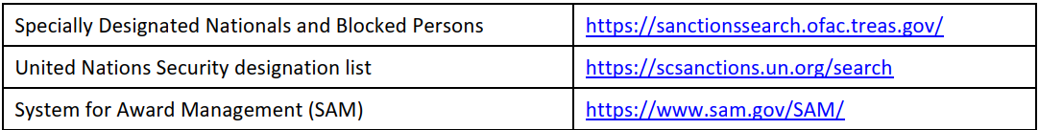
Debarment and Terrorism Searches
At a minimum, these searches should be performed through the public search engines outlined below:

Slide 46

M28. CONFLICT OF INTEREST (August 2018)
Conflict of interest is a situation in which a person has a private or personal interest sufficient to appear to influence the objective exercise of his or her official duties as an employee.
Required get COI policy signed by every staff and keep in the personal files

Slide 47
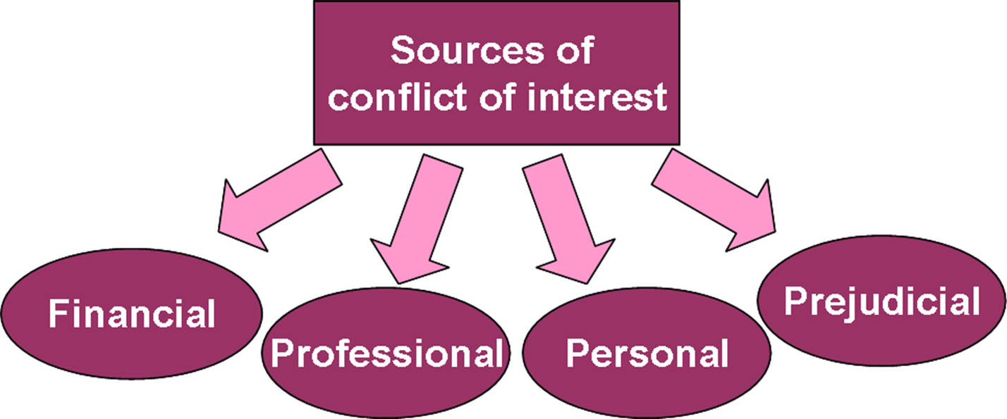
Sources

Slide 48
Examples of COI
Owning part of a business that sells goods or services to your organization while you are a member of the vendor selection committee
Sharing confidential information with a client or competitor
Accepting a favor or a gift from your vendors.
Engaging in employment or consultancy inconsistent with your organization’s interest.
Taking personal advantage of a business opportunity that your company might have pursued, itself

Slide 49

Quiz

Slide 50
M29. Prohibition on Certain Telecommunication and Video Surveillance Services or Equipment (July 2022)
Recipients and subrecipients are prohibited from obligating or expending grant funds to :
(1) Procure or obtain;
(2) Extend or renew a contract to procure or obtain; or
(3) Enter into a contract or extend or renew a contract to procure or obtain equipment, services, or systems that uses covered telecommunications equipment or services

Slide 51
M29. Prohibition on Certain Telecommunication and Video Surveillance Services or Equipment (July 2022)
covered telecommunications equipment is telecommunications equipment produced by Huawei Technologies Company or ZTE Corporation (or any subsidiary or affiliate of such entities) and
video surveillance and telecommunications equipment produced by Hytera Communications Corporation, Hangzhou Hikvision Digital Technology Company, or Dahua Technology Company (or any subsidiary or affiliate of such entities

Slide 52
RAA1. ADVANCE PAYMENT AND REFUNDS (NOVEMBER 2020)
The recipient is not required to maintain separate bank accounts for USAID funds, unless otherwise required.
When advances are authorized, the recipient must deposit such funds in a reputable bank and
Be able to account for the receipt and expenditure of funds and interest earned on the advances provided.

Slide 53
RAA1. ADVANCE PAYMENT AND REFUNDS (NOVEMBER 2020)
The recipient must maintain advances of USAID funds in interest-bearing accounts, unless:
  The recipient receives less than $250,000 per year;
  The best reasonably available interest-bearing account would not be expected to earn interest in excess of $500 in a twelve month period;
  The bank would require an average or minimum balance so high that it would not be practical to maintain the advance in an interest-bearing account; or
  A foreign government or banking system prohibits interest bearing accounts.

Slide 54
RAA1. ADVANCE PAYMENT AND REFUNDS (NOVEMBER 2020)
The recipient may retain up to $500 of interest earned in a twelve-month period on cash balances for administrative expenses. Any additional interest earned on advances must be remitted to prime.

Slide 55
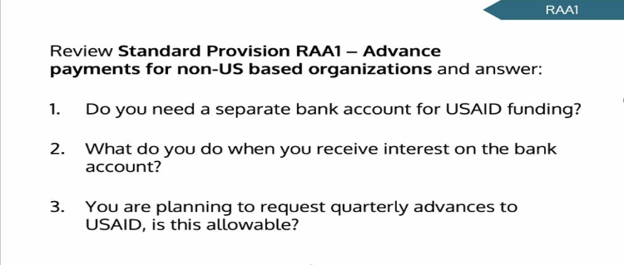
EXCERCISE

Slide 56
RAA11. REPORTING HOST GOVERNMENT TAXES (DECEMBER 2022)
Definitions:
Foreign government includes any foreign governmental entity.
Foreign taxes include value-added taxes and customs duties assessed on procurement of goods and services.
Report:
  The recipient must submit a report detailing foreign taxes assessed during prior year. The report must be submitted annually by April 16.
  A report is required even if the recipient did not pay any foreign taxes during the reporting period.
  A cumulative report may be provided if the recipient is performing more than one award.
  Report includes any individual transaction of more than $500 should be reported.

Slide 57
Reporting Requirements
Reports | Frequency
SFR | Monthly
SFR Accrual | Quarterly
QNR/QWP/Narrative Reports | Monthly/Quarterly
Cost Share | Quarterly
VAT Reports | Annually
Inventory Reports | Annually including physical verification report
Audit Report, Management Letter | Annually
DAO, SWC, Tax Exempt Certificate | Annually (as applicable)
Audit Monitoring per M2 End of Project Report (EoPR) | Annually 30 Days after POP ends

Slide 58
Documentation by Expenses Category
Salaries | Payroll report Time sheet Time and salaries must be actual not budgeted one Salary rate must be per employment contracts issued and payroll records Verification of Debarment and Terrorism Searches

Slide 59
Documentation by Expenses Category
Fringe Benefits | Detail itemized by employee Appropriate supporting calculation and copy of regulation or organizational policy that explains or mandates the benefit Evidence of payroll withholding, taxes, insurance, pension, and other required payroll obligations

Slide 60
Documentation by Expenses Category
Consultants | For initial payment: ✓ Copy of signed consultancy agreement/contract ✓ Documentation of selection process including price reasonableness and documentation of competition ✓ Verification of terrorism and debarment searches {Excluded Parties List (Debarred, Suspended, and Ineligible Contractors), OFAC list as ineligible, UN List of Sanctioned Entities as ineligible} ✓ Consultant invoice ✓ Certification of deliverables & time worked by the consultant as stated in the agreement by person overseeing the consultancy on behalf of the subrecipient

Slide 61
Documentation by Expenses Category
Consultants | For subsequent payments: ✓ Consultant invoice ✓ Certification of deliverables and time worked by the consultant as stated in the agreement by person overseeing the consultancy on behalf of the subrecipient ✓ Documentation supporting bank payment transfers and schedules submitted to local government for payment of consultant taxes submitted during the period, if

Slide 62
Documentation by Expenses Category
Travel, Transport and Per Diem | Copy of approval for travel EA/TO etc Receipt/Invoices for lodging, airfare, car rental etc Per Diem calculation per policy Documentation of dates, travelers, programmatic necessity Trip Report

Slide 63
Documentation by Expenses Category
Procurements | Approval from donor if applicable Purchase Requisition RFP for collection of quotations Vendor Selection Process-Competition, price and reasonableness, Purchase Order Good Receipt Note/Services performed or delivered Invoices Debarment & Terrorism Searches (SAM, OFAC & UN)

Slide 64
Documentation by Expenses Category
Workshop/Training/ Meetings | Agenda's Participants attendance sheet Listing and acknowledgement of transport/meal/per diem allowance payment Evidence of vendor selection, cost reasonableness for procurement of venue, refreshments, and other associated procurements Activity reports

Slide 65
Documentation by Expenses Category
Other Direct Costs | Receipts or invoice for all items Goods received note signed by the employee who received item(s), when applicable Evidence of vendor selection process and price reasonableness Purchase order, if applicable Verification of terrorism and debarment searches (Excluded Parties List [Debarred, Suspended, and Ineligible Contractors], OFAC list as ineligible, UN List of Sanctioned Entities as ineligible), if applicable

Slide 66
Upcoming Changes
In April 2024, the OMB issued revisions to several parts of the 2 CFR 200 (Uniform Administrative Guidance).
The effective date for the final guidance is October 1, 2024. Agencies may elect to apply the final guidance to awards issued prior to October 1, 2024, but they are not required to do so.
However, the effective date for the increase in the audit thresholds are not clear.

Slide 67
Key Changes
Single Audit or Program Specific Audit threshold increased from $750,000 to $1,000,000.
Equipment threshold for retention, sale, or disposal raised from $5,000 to $10,000.
Unused supplies threshold required to be sold at the end of a award period increased from $5,000 to $10,000.
De Minimis indirect rate increased from 10% to 15%.
Amount of subawards recipients can apply to the indirect rate raised from $25,000 to $50,000.
Simplified Acquisition Threshold (SAT) limit for fixed amount subawards increased from $250,000 to $500,000

Slide 68
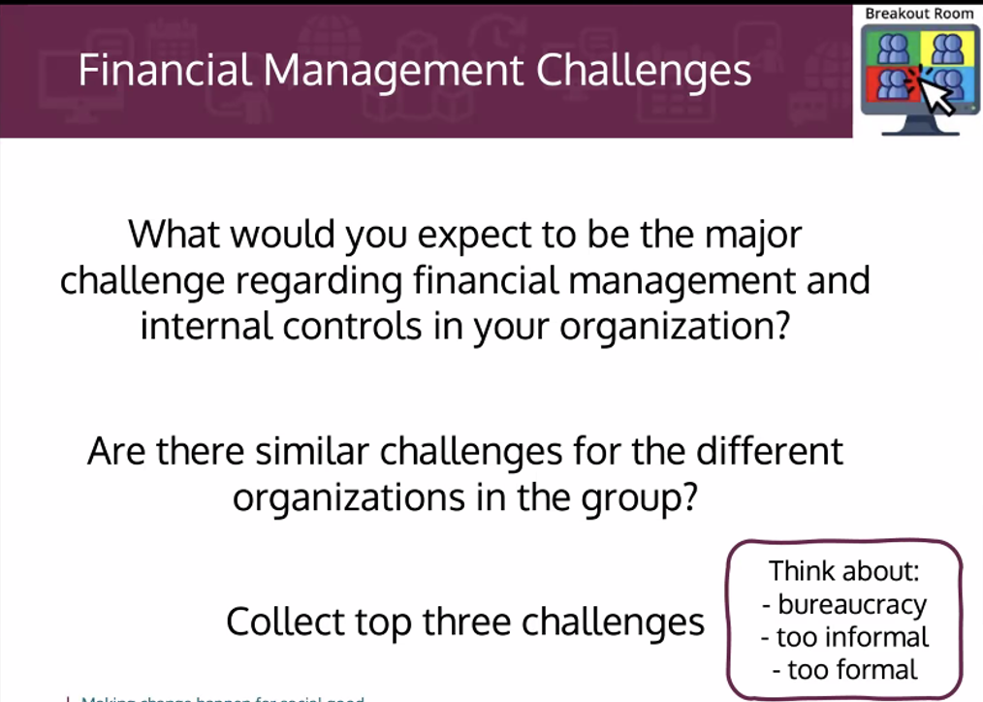
Financial Management

Slide 69
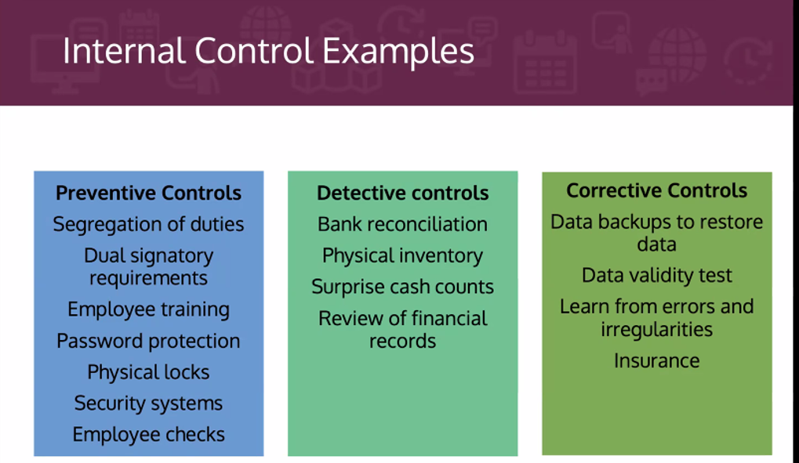
Internal Control

Slide 70
What is Subaward Monitoring?
Systematic and ongoing process of information gathering, review, and analysis
Starts from selection process to closeout phase of the grants
Conducted jointly by Grants unit and program unit
Provides current status and progress
Monitoring is an integral part
of award management and
implementation.

Slide 71
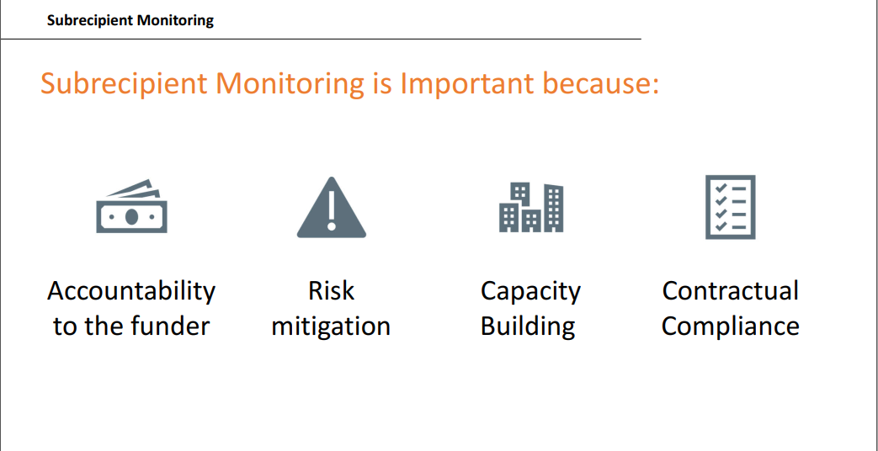
Importance

Slide 72
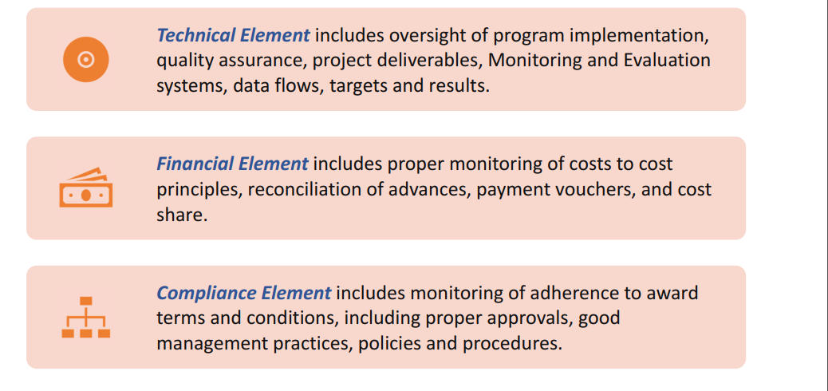
Elements in monitoring

Slide 73
Monitoring Activities
Each subaward activity needs to be monitored to ensure that it meets its performance goals and contractually is compliant.
Review of Program and Data Reports | Site Visits | Tracking Contractual Compliance | Subrecipient Audits (as required)
Review and progress tracking: Weekly and monthly progress tracking Monthly Review Meeting Quarterly Data Verification Semi-annual Data Quality Assessment Planning & Reporting: Quarterly Work Plan Program updates Project Indicator Form Quarterly Narrative Report Final Narrative Report EMMP | If it is not possible or practical for annual site visits to occur, this needs to be documented and archived in the subaward file. Annual site visits by Grants Unit Supportive supervision and onsite coaching by different units (SI, Technical, SBC etc) | SFR Budget vs Expenditure Quarterly Budget Projection SAT/DPA Special Award Condition Substantial involvements VAT reporting Inventory reporting Cost share if any | Monitor the threshold for audit. Audited for local requirements and reported. Corrective action as pointed out in the audit management letter

Slide 74
Challenges at Subawardee Level
Staff turnover
Unclear policies (petty cash, document disposal & retention, asset management, procurement etc.)
Need maximum effort to settle monitoring issues
Inadequate awareness on compliance requirement
Not communicated for support in time
Capacity building need
Renewal at concerned government line agencies

Slide 75
Sample Observations
Personal Files
Salary increment notification letter not issued to staff
Job Description not attached with employment contract
Tax withheld not uploaded in government web site
Debarment and Terrorism Searches not performed/missing
Time sheet
Time sheet not approved on timely manner
Leave record
  Leave form not approved, leave record not updated regularly
  Lease Agreement
  Clauses missing for termination, tax withholding, payment method etc
  Asset Management
  No periodical physical verification, records not maintained / updated
  Inventory code and USAID stickers not affixed

Slide 76
Sample Observations
  Procurement
  Complete documents not attached with vouchers
  Procurement procedures not followed (organizational policy & standard procedures)
  Petty Cash
  Surprise check not performed
  Payment made exceeding single payment transaction limit
Advance
  Program advance request form and Travel authorizations forms not approved before issuing advance
  Trip reports not attached with travel claim
  Advance not settled within time
  Others
  Expenses charged to the wrong budget line, copy of check missing in some cases, VAT invoices not forwarded in timely manner

Slide 77
Group Exercise
You are reviewing some of the documents made available by subawardee. Review the documents in your group and list your observations and recommendations.
Case 1: Provided few different types of time sheet and local transportation cost claim sheet
Case 2 : Provided few procurement vouchers
A member from each group should present the observations and recommended action (15 minutes for preparation and 5 minutes for presentation and discussion)

Slide 78
Thank You!

