Slide 1
Grants and Financial Management Training
May 22-24, 2024
Pokhara,Kaski

Slide 2
OVERALL OBJECTIVES
Enhance capacity of our implementing partner on grants and financial management.
The training will contribute to the indicator of capacity development of implementing partners.
Will have increased impact on financial documentation, governance system, reporting, and grants compliances which will ultimately support to achieve greater objectives of the organization.

Slide 3
SPECIFIC OBJECTIVES
Understand the USAID cost principle: Reasonable. Allocability & Allowability.
Understand basic rules about interest Earned, Ineligible and Restricted Items,
Debarment and terrorism searches.
Gain clarity on preparation of Human Resources for Health reporting.
Identify the local compliance requirements related with Tax/VAT
Improve the overall inventory management
Prepare and submit qualitative financial report
Improve internal control mechanisms
Analyze budget monitoring reports and budget management techniques and tools which will support improving the burn rate of the Implementing Partners.

Slide 4
Standard Provisions for Non-U.S. Nongovernmental Organizations
Mandatory Provisions (M) | Required As Applicable (RAA)
32 | 31

Slide 5
Contracts and Grants
Contracts | Grants and Cooperative Agreements
Mechanism for acquisition/procurement | Mechanism for assistance
U.S. Government is the buyer, exercise full control | U.S. Government is the sponsor, limited involvement and for public purpose
U.S. Government is the primary beneficiary | The recipient is the primary beneficiary (Public at Large/communities)
Contracts Officer | Agreement Officer/Grants Officer
Contracting Officer’s Technical Representative (COTR) | Agreement Officer’s Technical Representative (AOTR)
Request for Proposal (RFP), Federal Acquisition Regulation (FAR) | Request for Application (RFA), Code of Federal Regulation (CFR)

Slide 6
Awarding Process
Pre-award
Award
Post-award
Closeout

Slide 7
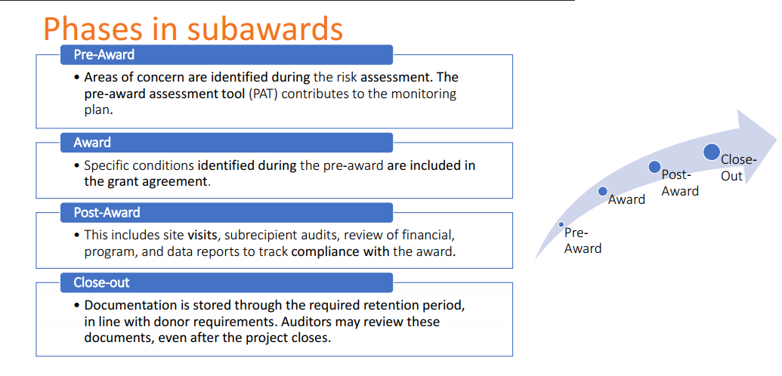
Awarding Process

Slide 8
Cost Share Vs Shared Cost (Cost Allocation)
Cost Share-leverages or additional resources contributed by grantee (time, supplies, cash, property and equipment, complimentary projects etc)
Shared cost: costs that benefits more than a program projects. A cost allocation plan is a written summary which shows how an organization may share costs across many projects.

Slide 9
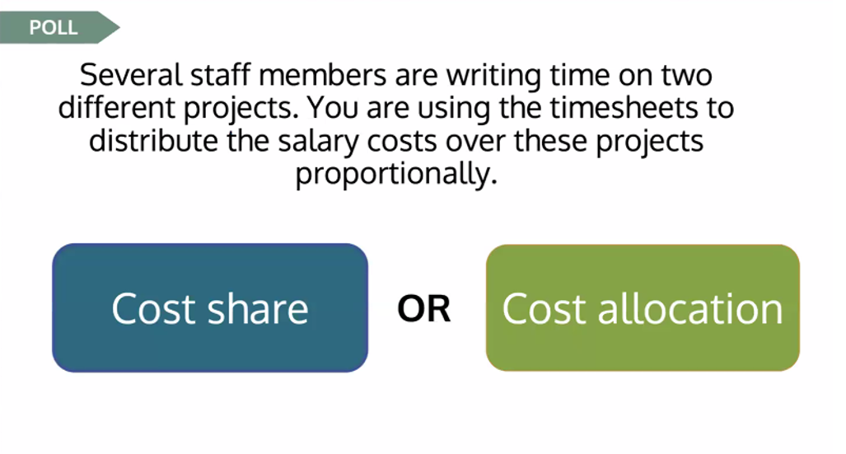
Cost Share vs Cost Allocation

Slide 10
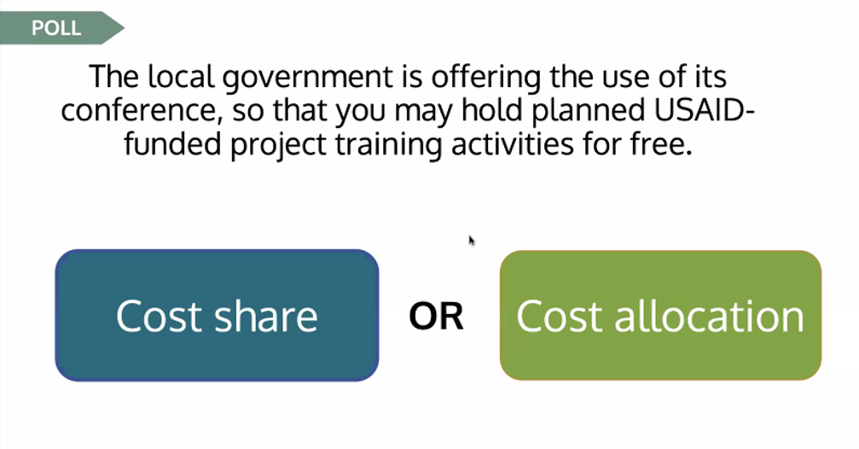
Cost Share vs Cost Allocation

Slide 11


