Slide 1
Grants and Financial Management Training
May 22-24, 2024

Slide 2
M2. ACCOUNTING, AUDIT, AND RECORDS (MARCH 2021)
The recipient is required to have an annual audit for any recipient fiscal year in which the recipient expends a combined total of more than $750,000 in all federal awards, either directly or through a prime contractor or recipient.
USAID/FHI 360/or any designated agency retains the right to conduct financial review, require an audit, or otherwise ensure adequate accountability of organizations expending USAID funds, regardless of the audit requirement

Slide 3
M2. ACCOUNTING, AUDIT, AND RECORDS (MARCH 2021)
The audit report must be submitted within 30 days after receipt of the auditor’s report, but no later than nine months after the end of the period audited.
FHI 360 will review this report to determine whether it complies with the audit requirements of this award. FHI 360 will only pay for the cost of audits conducted in accordance with the terms of this award.
In cases of continued inability or unwillingness to have an audit, FHI 360 will consider appropriate actions which may include suspension of all, or a percentage of, disbursements until the audit is satisfactorily completed.

Slide 4
How Does FHI 360 doing this?
FHI 360's Action:
    A. FHI 360 HQ is monitoring, and CO is facilitating on this
    B. Audited per M2
Sample Email

Slide 5
What is Subaward Monitoring?
Systematic and ongoing process of information gathering, review, and analysis
Starts from selection process to closeout phase of the grants
Conducted jointly by Grants unit and program unit
Provides current status and progress
Monitoring is an integral part
of award management and
implementation.

Slide 6
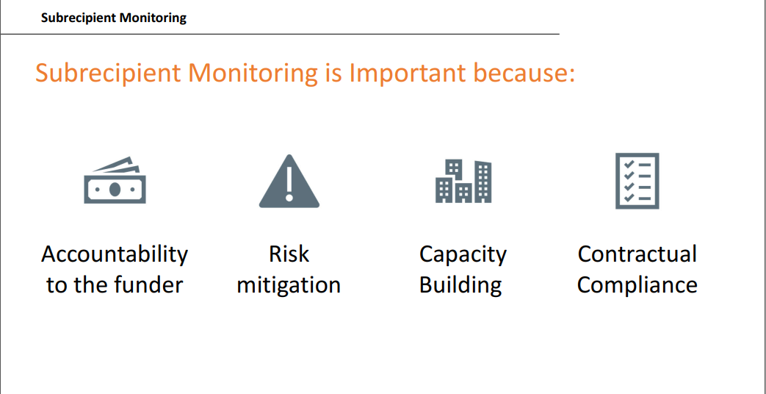
Importance

Slide 7
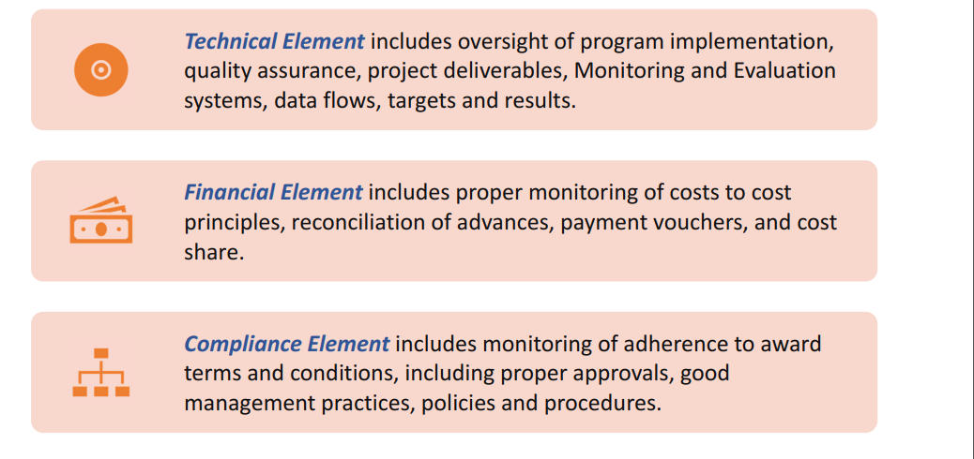
Elements in monitoring

Slide 8
Monitoring Activities
Each subaward activity needs to be monitored to ensure that it meets its performance goals and contractually is compliant.
Review of Program and Data Reports | Site Visits | Tracking Contractual Compliance | Subrecipient Audits (as required)
Review and progress tracking: Weekly and monthly progress tracking Monthly Review Meeting Quarterly Data Verification Semi-annual Data Quality Assessment Planning & Reporting: Quarterly Work Plan Program updates Project Indicator Form Quarterly Narrative Report Final Narrative Report EMMP | If it is not possible or practical for annual site visits to occur, this needs to be documented and archived in the subaward file. Annual site visits by Grants Unit Supportive supervision and onsite coaching by different units (SI, Technical, SBC etc) | SFR Budget vs Expenditure Quarterly Budget Projection SAT/DPA Special Award Condition Substantial involvements VAT reporting Inventory reporting Cost share if any | Monitor the threshold for audit. Audited for local requirements and reported. Corrective action as pointed out in the audit management letter

Slide 9
Challenges at Subawardee Level
Staff turnover
Unclear policies (petty cash, document disposal & retention, asset management, procurement etc.)
Need maximum effort to settle monitoring issues
Insufficient awareness on compliance requirement
Not communicated for support in time
Capacity building need
Renewal at concerned government line agencies
Internal team coordination, communication and cooperation

Slide 10
Sample Observations
Personal Files
Salary increment notification letter not issued to staff
Job Description not attached with employment contract
Tax withheld not uploaded in government web site
Debarment and Terrorism Searches not performed/missing regularly
Yearly performance appraisal is not performing in a good way.

Slide 11
Sample Observations
Time sheet
Time sheet not approved on timely manner
Leave record
  Leave form not approved, leave record not updated regularly, leave form not filled and not verified with time sheet.

Slide 12
Sample Observations
  Lease Agreement
  Clauses missing for termination, tax withholding, payment method etc.
  Cost sharing to multiple projects/donors mechanism not finalized.
  Asset Management
  No periodical physical verification, records not maintained /updated
  Inventory code and USAID stickers not affixed

Slide 13
Sample Observations
  Procurement
  Complete documents not attached with vouchers
  Basic required documents not found (PR, PO, GRN, Quotation, Complete set of Legal Documents, Cost comparison sheet etc.), delay documentation (documents prepared after completion of procurement)
  Date mismatched (PO, PR, GRN, Quotation date not in a sequence)
  Procurement procedures not followed (organizational policy & standard procedures, Local law)

Slide 14
Sample Observations
  Petty Cash
  Surprise check and cash count not performed, not in written record
  Payment made exceeding single payment transaction limit
  Timely/proper closing not done as per organization’s policy

Slide 15
Sample Observations
Advance and settlement
  Program advance request form and Travel authorizations forms not approved before issuing advance
  Smart advance plan, detail budget plan for huge advance
  Complete supporting documents not attached with the voucher
  Trip reports not attached with travel/event claim
  Advance not settled within time
  Others
  copy of check missing in some cases, VAT invoices not forwarded in timely manner

Slide 16

Thank you

